Slide 1
Breast Cancer Prediction
OASIS ANALYTICS
30/01/2023

Slide 2
AGENDA
Project Recap
Problem
Meet The Team
Process
Workflow
Insights
Model Development
Results
Business Benefit
Summary

Slide 3
Project recap
PRIMO Cancer Research Institute (PCRI) is a non-profit organization dedicated to studying and understanding the biology of cancer, developing new treatments and therapies, and improving the lives of those affected by the disease.
Oasis Analytics has been tasked with developing a Machine Learning Model for Primo Cancer Research Institute to help their researchers improve the accuracy of their cancer diagnosis and prognosis.
The expectations are:
Create meaningful insights and visuals using the FNA dataset.
Develop a ML model with high accuracy and precision.

Slide 4
Problem
How can researchers at PCRI improve the accuracy of cancer diagnosis and prognosis, and ultimately develop more effective treatments for patients?

Slide 5
Meet THE team

Slide 6

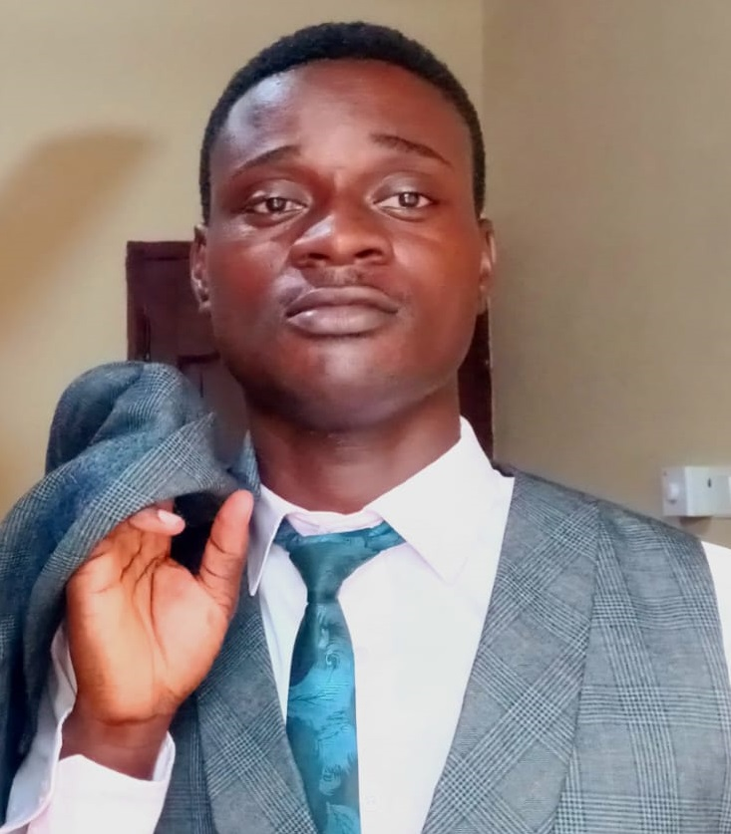

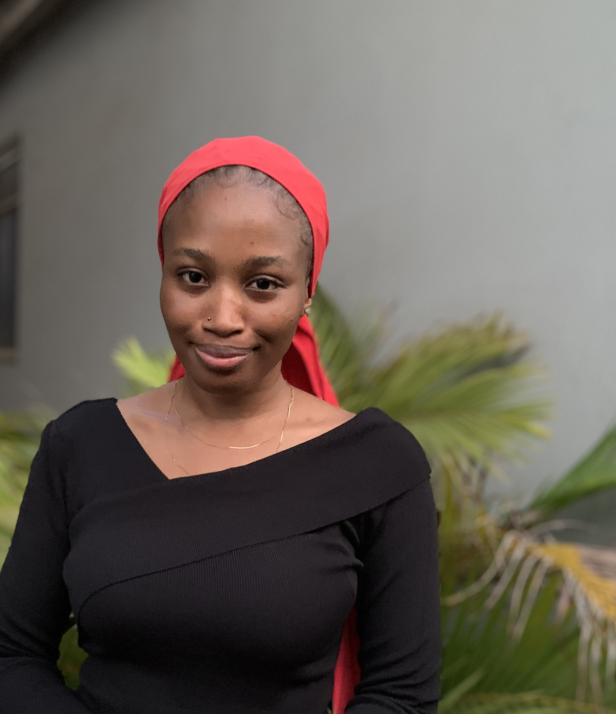




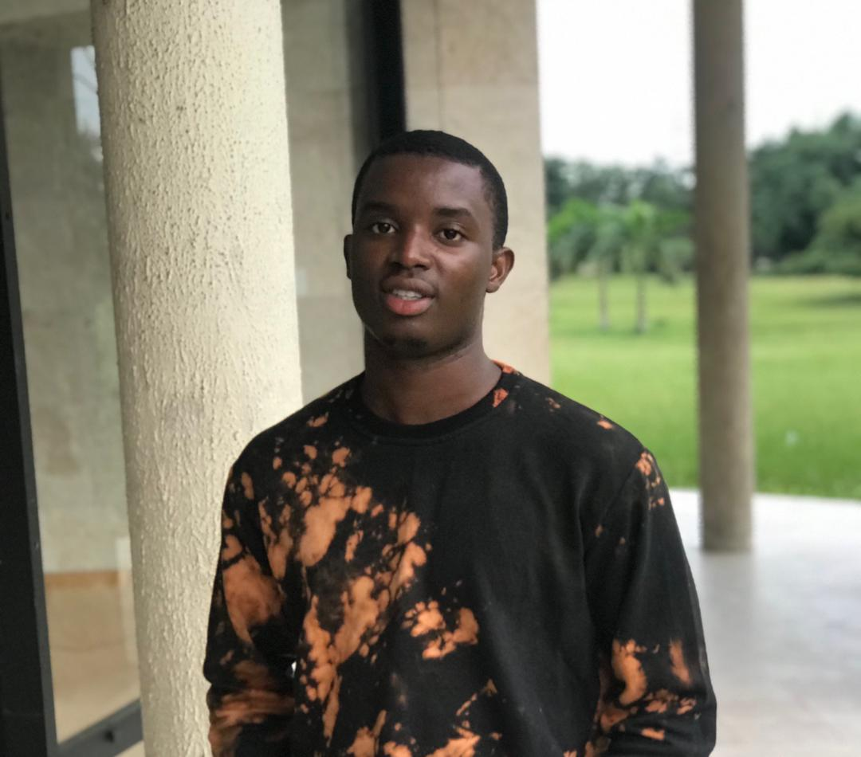
Data engineering
JOHN ALABI
RUTHERFORD BRANDFUL
Data analytics
EZRA MANUEL
MOBOLAJI ADEJONRIN
CHIEBUKA OKORO
ROHULLAH ETTU
Data science & Machine learning
NANCY ARMAH
DENGIMOWEI ALABINTEI
OLANREWAJU OBE

Slide 7
PROCESS
1.
Business Problem Understanding
2.
Source Data
3.
Create Database and Load Data
4.
Data Modelling
5.
Data Analysis & Visualization
6.
General insights
7.
Model Development

Slide 8
DATA ENGINEERING

Slide 9

DATA SOURCE
Kaggle

Slide 10
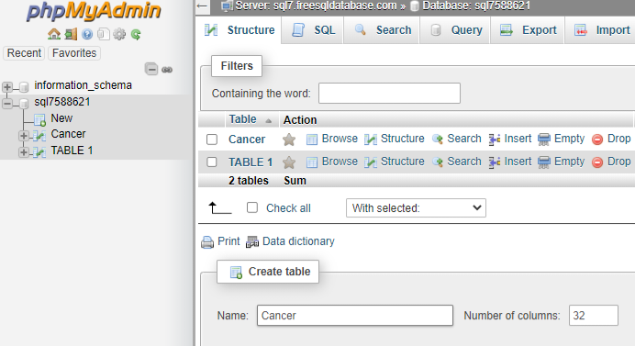
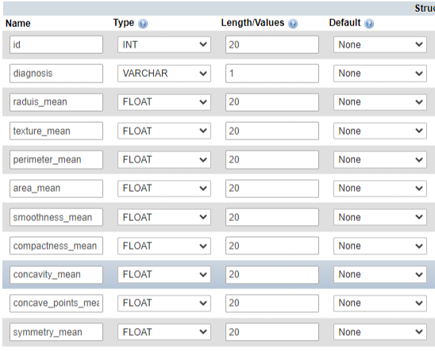

CREATION OF ONLINE DATABASE USING MySQL
Set Data Type & Length
Create Table

Slide 11
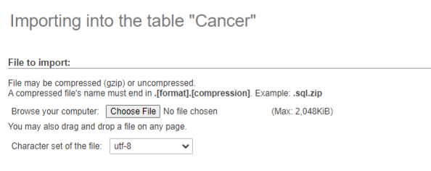
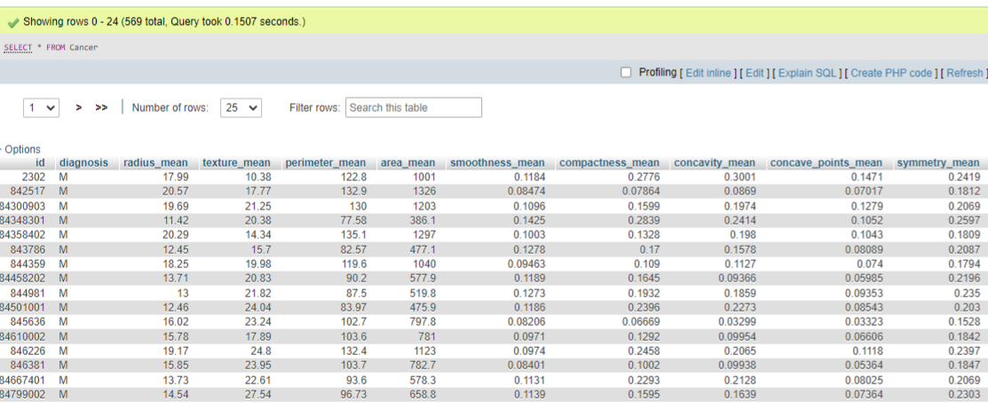
Load into database
Import CSV File
View Table

Slide 12
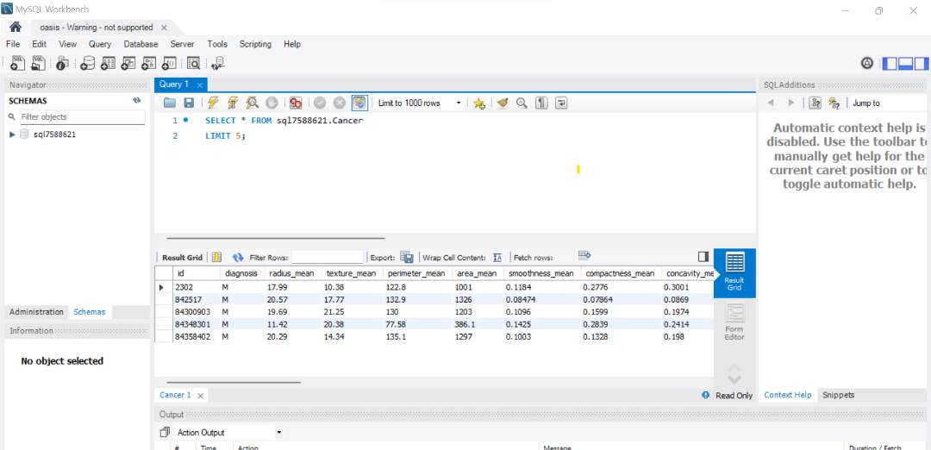
Accessing the online database via MySQL IDE

Slide 13
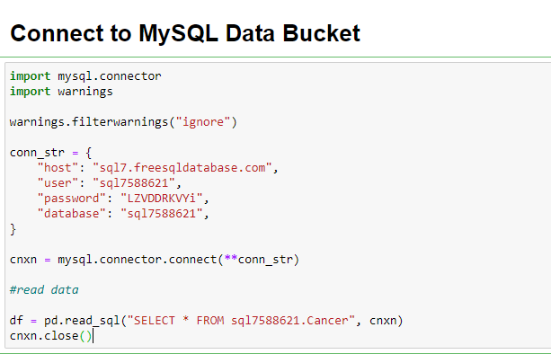

Connect Jupyter Notebook

Slide 14
DATA Analytics

Slide 15
QUANTITATIVE CELL ATTRIBUTES
COMPUTATIONAL ATTRIBUTES:
- MEAN
- STANDARD ERROR
- WORST
1.
radius
2.
perimeter
3.
area
4.
texture
5.
smoothness
6.
compactness
7.
concavity
8.
concave points
9.
symmetry
10.
fractal dimension

Slide 16
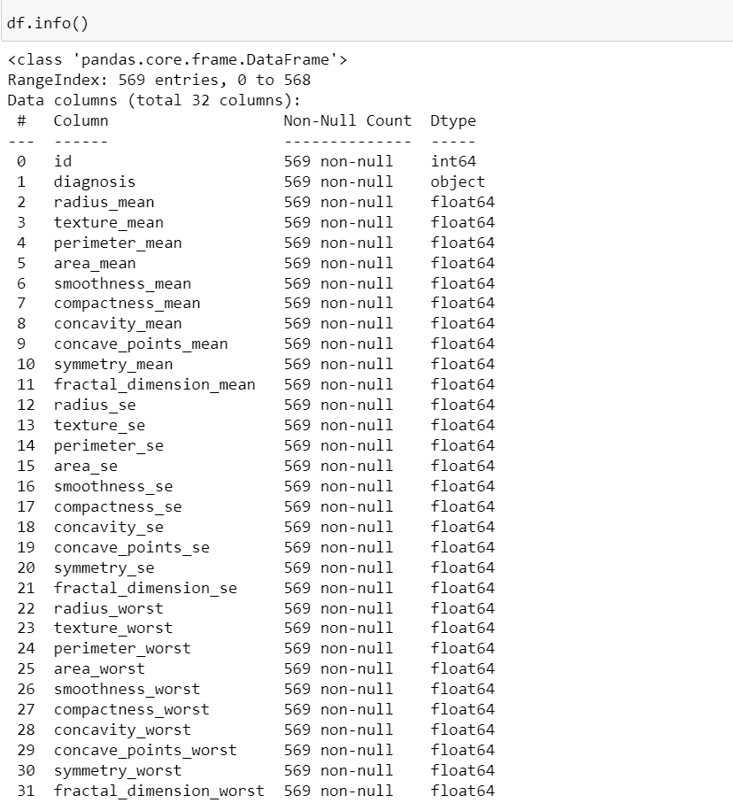
Features

Slide 17
INSIGHTS
100%
30
569
Of observations are non-null values
Unique Attributes
Observations

Slide 18
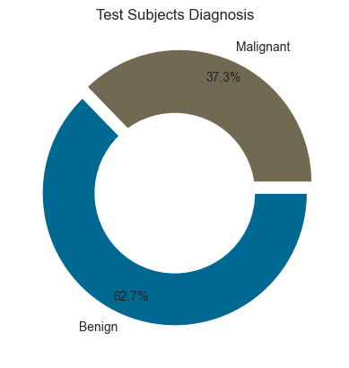
Diagnosis is split into Benign (B) and Malignant (M)
357 (62.7%) records/observations are captured for Benign cells
212 (37.3%) records/observations are captured for Malignant Cells

Slide 19
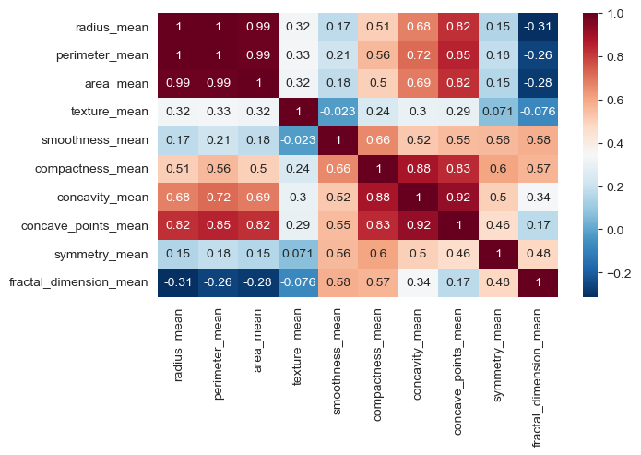
CORRELATION OF THE MEAN FEATURES

Slide 20
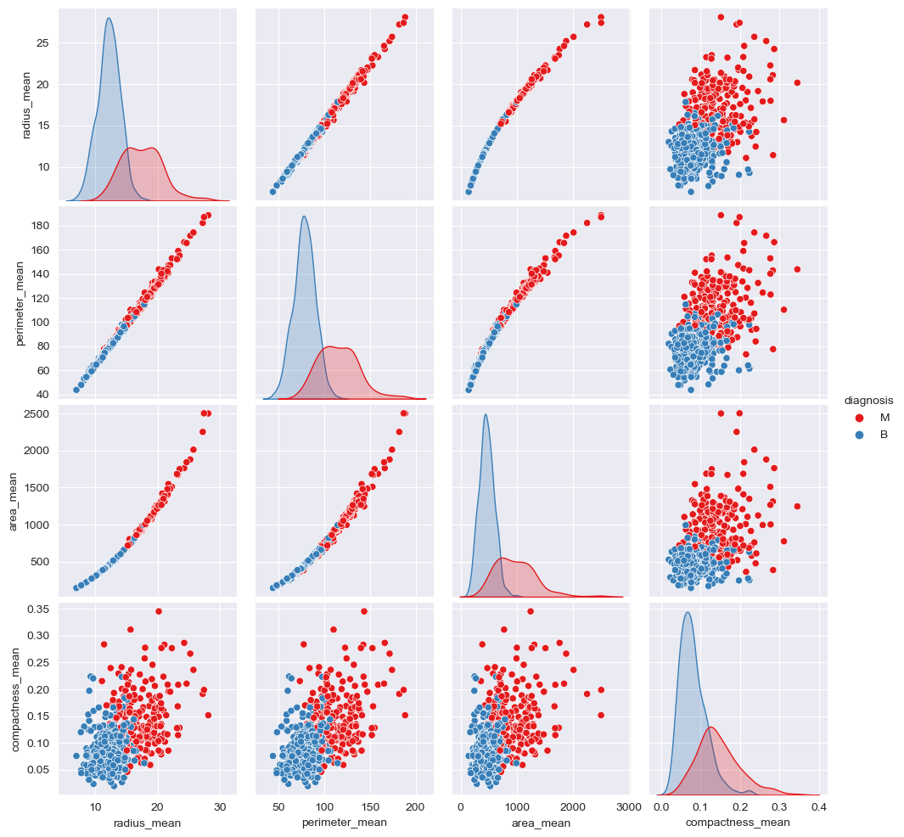
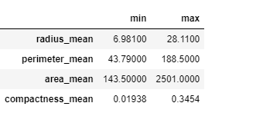
DISTRIBUTION OF THE MEAN OF THE RADIUS, PERIMETER, AREA AND COMPACTNESS OF THE CELLS

Slide 21
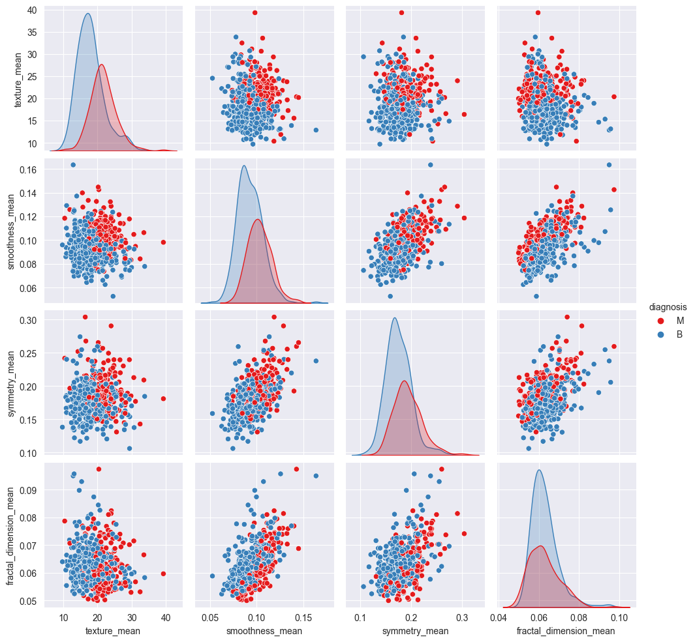
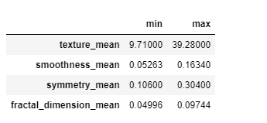
DISTRIBUTION OF THE MEAN OF THE TEXTURE, SMOOTHNESS, SYMMETRY AND FRACTAL DIMENSION OF THE CELLS

Slide 22
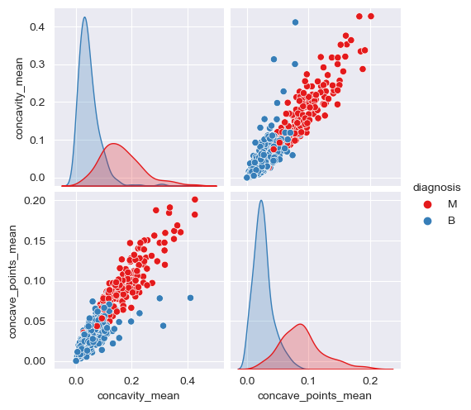
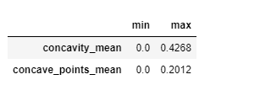
DISTRIBUTION OF THE MEAN OF THE CONCAVITY AND CONCAVE POINTS OF THE CELLS

Slide 23
MACHINE learning

Slide 24
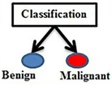
0
1

Slide 25
MODEL DEVELOPMENT
MODELS
TRAINING
EVALUATION
Logistic Regression
Random Forest
K-Nearest Neighbors (KNN)
Support Vector Machine (SVM)
Training Data – 80%
Testing Data – 20%
Model trained on all features.
Model trained on best 10 features.​​​
Accuracy
Confusion Matrix
Classification Report

Slide 26
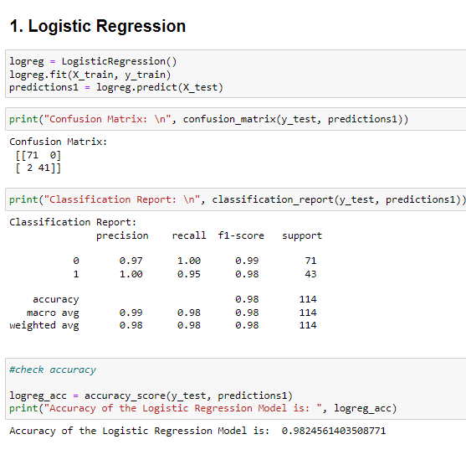
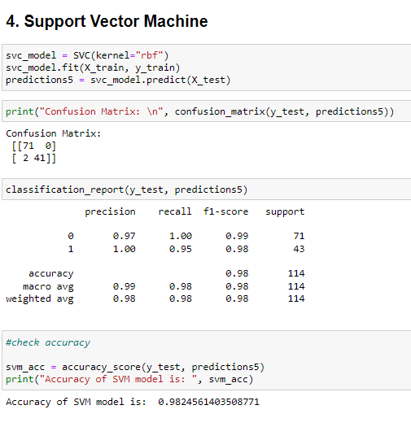
Model trained on all features
Accuracy – 98.25%

Slide 27
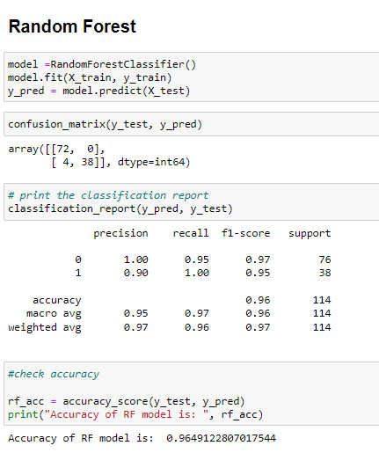
Model trained on best 15 features
Accuracy – 96.50%

Slide 28
BUSINESS BENEFIT
Improved Patient Outcome
Increased efficiency
Reduced healthcare costs
Improved patient experience
Competitive edge
Research

Slide 29
SUMMARY
The goal of this project was to develop a Machine Learning Model with a high accuracy and precision and Logistic Regression and SVM have both achieved an accuracy of 98.2%.
This represents a major step forward in the fight against cancer and has the potential to greatly assist physicians in making accurate and timely diagnoses.
We look forward to further testing and implementing this model in clinical settings to help improve patient outcomes.

Slide 30
Reference Links
GitHub
Dashboard

Slide 31
THANK YOU

